Slide 1


















Future State Infra Architecture in AWS (Driver Distraction Alert - DDA)
The future-state architecture integrates diverse technologies for high availability (HA) and auto scale support
AWS Cloud
AWS WAF
Amazon Route 53
Internet
Region
Availability Zone 1
Availability Zone 2
VPC
Amazon SNS
Application
Gateway
Amazon Cognito
Private Subnet
Private Subnet
Mobile
Lambda
Amazon SQS
Lambda
Lambda
Private Subnet
Private Subnet
Amazon S3
Mobile
Location Service
Location Service
Amazon Athena
Amazon Quick Sight

Slide 2
DR Infra Architecture in AWS (Driver Distraction Alert - DDA)
The future-state architecture integrates diverse technologies for high availability (HA) and auto scale support
AWS Cloud
Failover routing policy re-directs to secondary region
AWS WAF
Amazon Route 53
Internet
Region
Availability Zone 1
Availability Zone 2
VPC
Amazon SNS
Application
Gateway
Amazon Cognito
Private Subnet
Private Subnet
Mobile
Lambda
Amazon SQS
Lambda
Lambda
Private Subnet
Private Subnet
Amazon S3
Mobile
Location Service
Location Service
Amazon Athena
Amazon Quick Sight

Slide 3




Infra Architecture in AWS (Driver Distraction Alert - DDA)
The future-state architecture integrates diverse technologies for high availability (HA) and auto scale support
AWS Cloud
AWS WAF
Amazon Route 53
Internet
Region
Availability Zone 1
Availability Zone 2
VPC
Public Subnet
Public Subnet
NAT gateway
NAT gateway
Amazon SNS
Application
Gateway
Amazon Cognito
Private Subnet
Private Subnet
Mobile
Lambda
Amazon SQS
ElastiCache
for Redis
Lambda
ElastiCache
for Redis
Lambda
Private Subnet
Private Subnet
Amazon S3
Mobile
Location Service
Location Service
Private Subnet
Private Subnet
Amazon Athena
Amazon RDS -
For MySQL Instance
Amazon RDS -
For MySQL Instance
Amazon Quick Sight

Slide 4










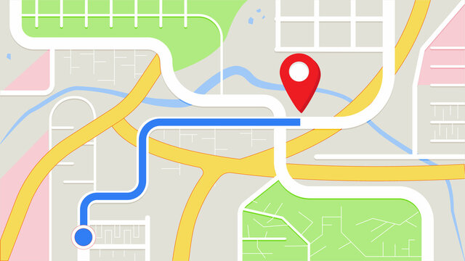









Driver Distraction Alert – Future state cloud architecture (Online mode) Representation of DDA’s components leveraging power of AWS cloud services for precise and updated PoI details with added compatibility of Android Automotive Infotainment System.
Inactive
Active
3
1
7
Amazon S3
Amazon Athena
Data Analytics Service
Amazon SNS
Alerts &
Notifications
Amazon SQS
4
6
Amazon QuickSight
(BI Service)
Amazon Cognito
2
ElastiCache
for Redis
iOS - Mobile client
Amazon
CloudWatch
Report Viewers
5
Amazon RDS -
For MySQL Instance
Amazon Route 53
Amazon API Gateway
0
AWS WAF
AWS Lambda
HERE Location Service
3
Internet
AWS Shared Service Account
Automatic Deployment
DevOps
Android Automotive Infotainment System
Build
AWS CodePipeline
AWS KMS
AWS CodeDeploy
AWS Device Farm
AWS CodeBuild
AWS CodeCommit
Developers
UI / UX Design
Android - Mobile client
Amazon S3
AWS Amplify
Amazon EC2
Notes:
Questions:
How application and DB are being authenticated? – IDP Azure
Please share version details of React, Scala (with play framework), Redis.
Please share below details for normal volume v/s peak volume – (Same as core)
Number of requests
Average response time
Number of concurrent users – 35% of total users
Network bandwidth utilization
CPU Utilization

Slide 5
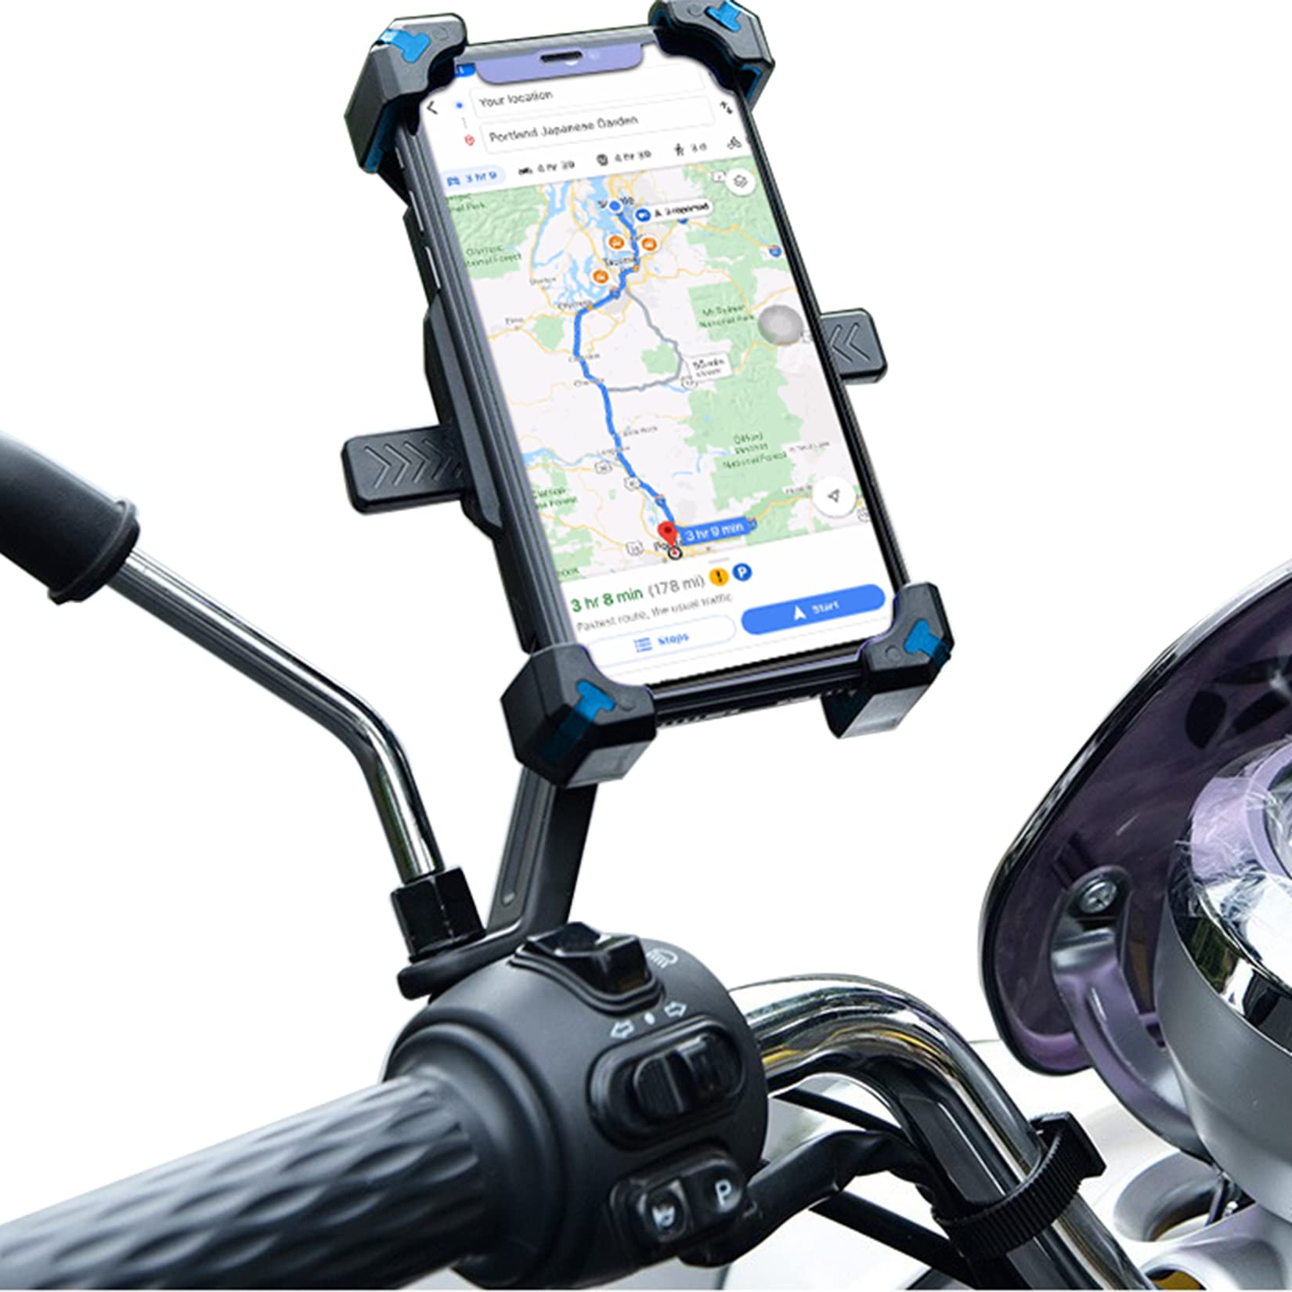
Driver Distraction Alert – Future state cloud architecture (Online mode) Designed for custom requirements of Saudi Arabia (if applicable) by integrating Google location services and mobile focused view for motorcyclist
Inactive
Active
3
1
7
Amazon S3
Amazon Athena
Data Analytics Service
Amazon SNS
Amazon SQS
Alerts &
Notifications
4
6
Amazon QuickSight
(BI Service)
Amazon Cognito
2
iOS - Mobile client
ElastiCache
for Redis
Amazon
CloudWatch
Report Viewers
0
5
Amazon RDS -
For MySQL Instance
Amazon Route 53
AWS WAF
Amazon API Gateway
AWS Lambda
Google Location Service
Android Automotive Infotainment System
3
Internet
AWS Shared Service Account
Automatic Deployment
DevOps
Build
AWS CodePipeline
AWS KMS
AWS CodeDeploy
AWS Device Farm
AWS CodeBuild
AWS CodeCommit
Developers
Mobile User on Motorcycle
UI / UX Design
AWS Amplify
Amazon EC2
Amazon S3
Android - Mobile client
Notes:
Questions:
How application and DB are being authenticated? – IDP Azure
Please share version details of React, Scala (with play framework), Redis.
Please share below details for normal volume v/s peak volume – (Same as core)
Number of requests
Average response time
Number of concurrent users – 35% of total users
Network bandwidth utilization
CPU Utilization

